Slide 1
Ladder Safety
General Use and Hazards

Slide 2
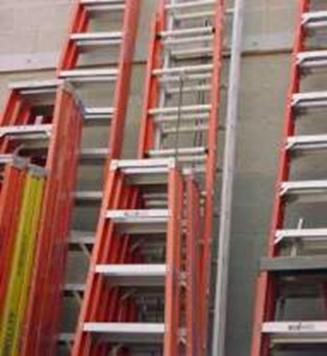
Ladders are a regularly used tool
Ladders are important and essential tools that are used widely in a variety of industries. They help us move up and down allowing us to work at different heights.
Portable ladders, in particular, are useful tools because they can be readily moved or carried. They are simply built and come in many sizes, shapes and styles.

Slide 3
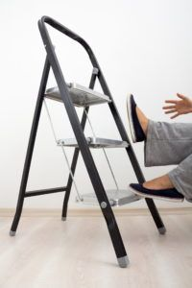
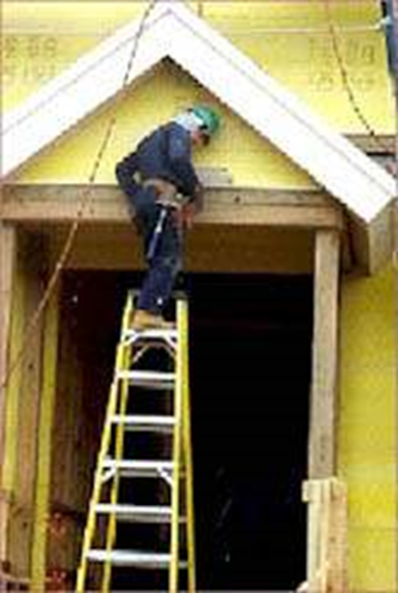
Proper use
Although ladders are easy to use, they are often misused or abused, causing serious injuries and deaths. These deaths and injuries could have been significantly reduced or eliminated with proper care and use.

Slide 4
Some Ladder Statistics
90,000 people received emergency room treatment from ladder related injuries
50% of all ladder related accidents were due to individuals carrying items as they climbed
32% of the injuries were fractures
Injuries were 77% male and most occurred at home (97%)
Elevated falls account on average of 553 deaths
These deaths account for 15% of all occupational deaths.

Slide 5
Reasons for falls from ladders
Improperly getting onto or off of the ladder.
Mis-stepping or a slipping of the foot while climbing or descending.
Being bumped by a cart or other object.
Having a vehicle run into or bump you.
People not paying attention to where they're walking.

Slide 6
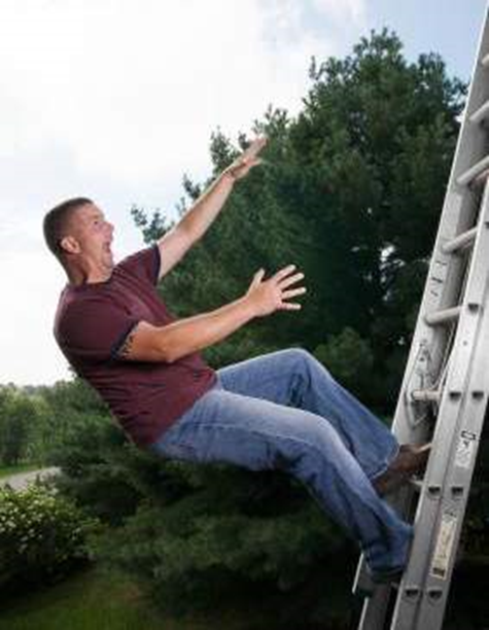
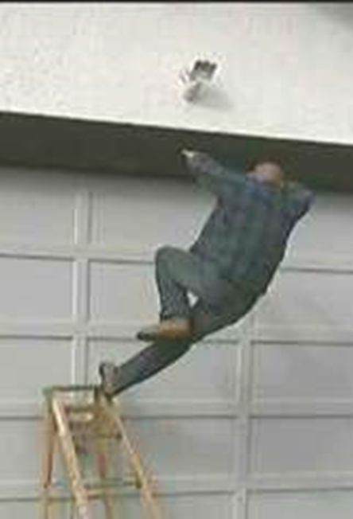
Most falls occur under 10 feet.
You don't have to fall far to get hurt. Workers injured in falls from ladders are usually less than 10 feet above the ladder's base of support.

Slide 7
Who is responsible?
Employers have a responsibility to make sure that each employee who uses a ladder understands how to use the ladder correctly on the job.
They must provide training to employees in recognizing hazards related to ladders and in the procedures they must follow to minimize these hazards.
Employees have a responsibility to observe the rules and follow the procedures established by their companies' programs, and to work safely when using ladders.
Homeowners need to exercise better judgment when on a ladder and seek training about ladder use.

Slide 8
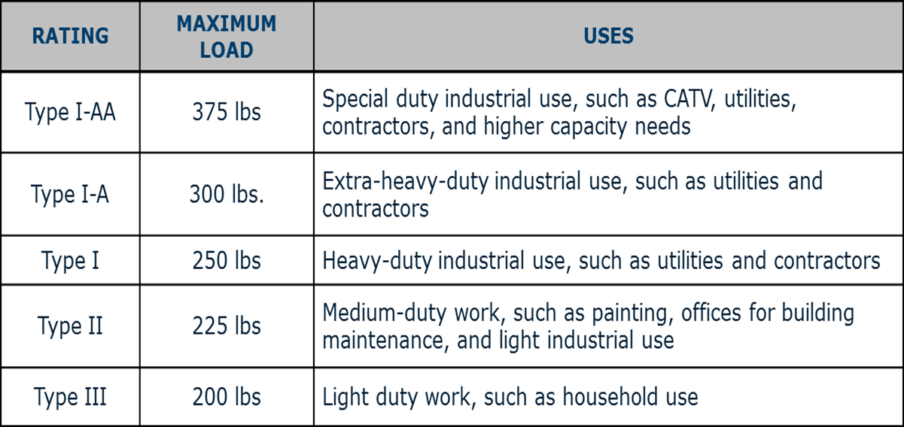
Ladder Ratings and Labels
Although there are many different kinds of portable ladders, they all receive a rating based on their maximum intended or working load - the total weight that they can safely support. This includes the weight of the worker, tools, and materials.

Slide 9
Ladder properties

Slide 10
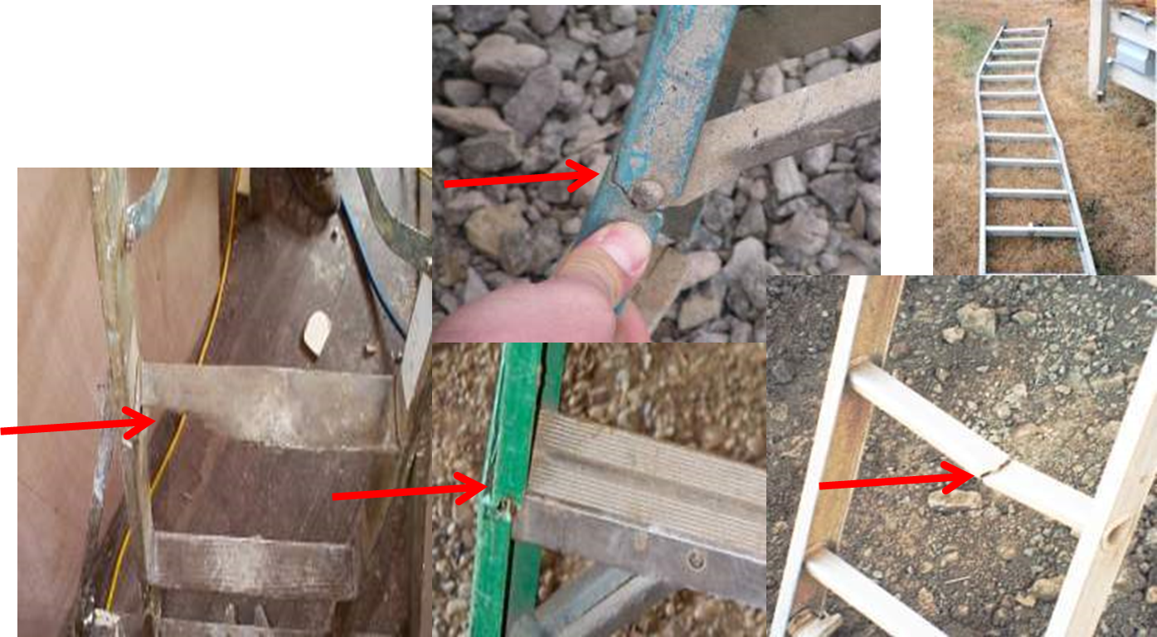
Inspect ladders before use
Look for cracks, splits, dents, bends, corrosion, and missing hardware.
Notes:
Now that you have figured out what ladder to use, inspect it to make sure it is not damaged and is ready for use.

Slide 11
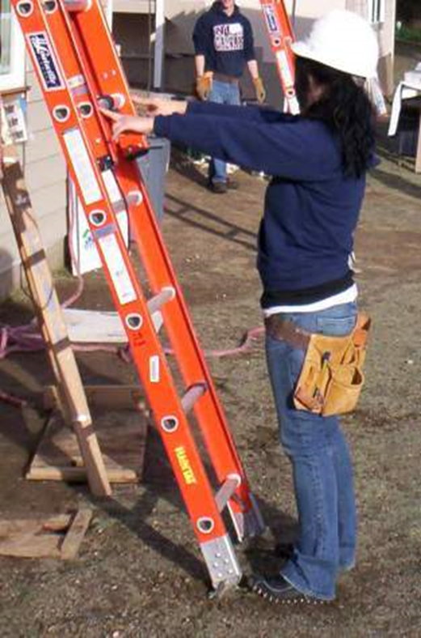
Determining proper ladder angle
One way to ensure proper angle is to stand with your feet at the base of the ladder and extend your arms straight out. If your hands just touch, the ladder will be very close to the 4 to 1 ratio. An example would be for a 12’ height, it should be 3 feet out from the wall.

Slide 12
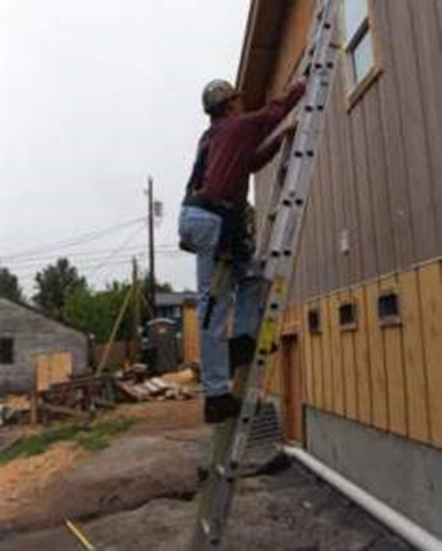
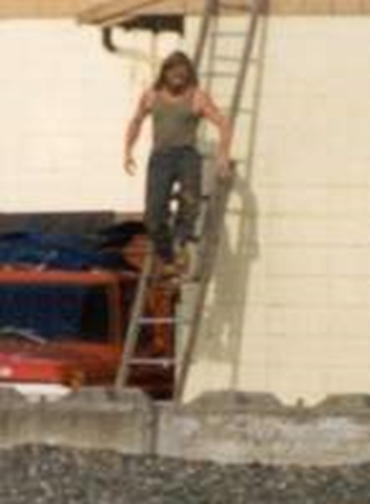
Climbing or descending a ladder
When climbing a ladder, you must have both hands free and face the ladder. This allows for three points of contact with the ladder at all times and reduces the chances of falling. The three point contact is two hands and one foot or one hand and two feet.
This way
Notes:
Going up = go at a normal speed. Accidents occurred most likely when ‘racing up’ the ladder
Going down = this is where most accidents occur is when going down. Need to be focused on what you are doing on the way down.

Slide 13
Here are some short videos. Pick one
The belt buckle rule
Ladders types and uses
Step ladder story
Don’t fall for it
Notes:
These are hyperlinked to RS SafetyTV

Slide 14
Questions

Slide 15
Question 1
You have to fall more than 15 feet from a ladder before you get hurt.
True
False
False – Workers injured in falls from ladders are usually less than 10 feet above the ladder’s base of support.

Slide 16
Question 2
Injuries from ladders can occur from:
Reaching too far out away from the ladder
Misstep or slip of the foot while climbing
Setting up the ladder on an unstable or slippery surface
All of the above
All of the above reasons may result in injuries from falls from ladders.

Slide 17
Question 3
A ladder is rated according to:
It’s size
How it is to be used
The total weight that it can safely support
The kind of material it is made of
Use ladders with a Type II, I, IA rating.

Slide 18
Question 4
A Type I ladder refers to:
A ladder made of fiberglass
A ladder rated for heavy industrial use, 250 lbs.
A ladder rated for household use, 200 lbs.
A ladder made of wood
Type I is made for commercial use which is needed to support the person and material.

Slide 19
Thank you for your time and if you have additional questions please contact
Safety at Retail Association Services;
360.943.9198
Or
safety@waretailservices.com
Notes:
Any questions? Thank you for coming today!
Additional information:
http://www.distraction.gov/content/about-us/index.html
http://www.textinganddrivingsafety.com/texting-and-driving-stats/
http://www.nsc.org/safety_road/Distracted_Driving/Pages/DistractedDrivingResearchandStatistics.aspx
http://www.cdc.gov/Motorvehiclesafety/Distracted_Driving/
http://www.amazinginfographics.com/statistics-and-facts-about-the-dangers-of-distracted-driving/
http://www.ghsa.org/html/publications/survey/distraction2013.html

