Slide 1
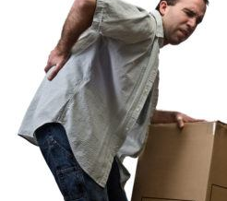
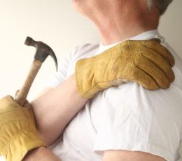
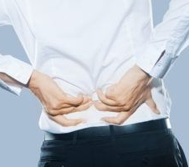
Overexertion
Backs and Shoulders

Slide 2
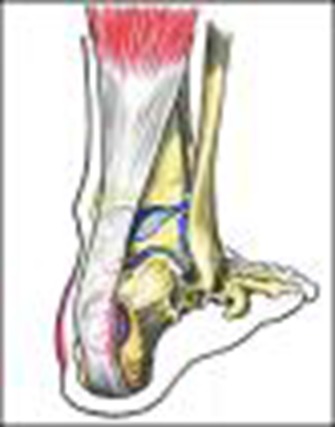
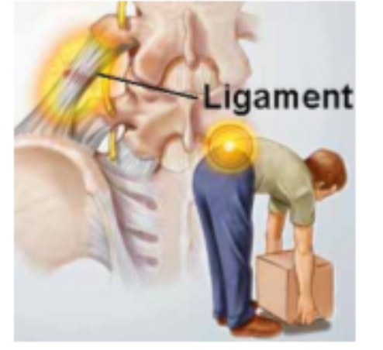
What is an Overexertion Injury?
Strains —stretching or tearing tendons or muscles. Muscles are attached to bones by tendons.
Sprains—stretching or tearing ligaments. Ligaments
attach bone to bone.

Slide 3
Shoulder facts
The shoulder is the most mobile joint in the human body. The four ‘rotator cuff’ muscles around the shoulder, support and stabilize the upper arm during movement.
According to the Bureau of Labor Statistics shoulder injuries keep people out of work on an average of 30 days compared to the back—12 days.
Notes:
Employees involved in tasks such as; painting walls, hanging curtains, repairing vehicles raised on a lift, filing and lifting objects… are at risk for shoulder injuries due to excessive overhead work.

Slide 4
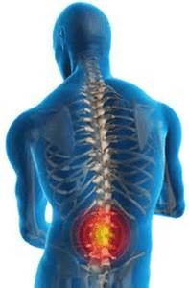
Back facts
Back Injuries:
Are very painful.
Difficult to heal.
Can turn into long term or life time disabilities.
Have an effect on everything you do.
Notes:
After suffering one back injury, you are much more likely to experience another one later on.

Slide 5
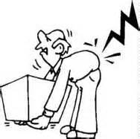
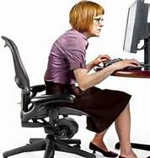
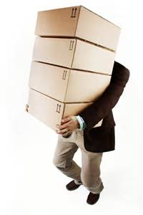
Overexertion injuries occur by…
•Improper lifting
•Repeated bending at the waist
•Bending at the waist with twisting
•Long term bending at the waist
•Reaching/over reaching
•Pushing/Pulling incorrectly
•Carrying - too much or not close to you
•Long term poor posture - sitting or standing
•Sitting while absorbing vibration through seat – truck/heavy equipment machinery.
Notes:
Lifting is the most frequently mentioned cause of overexertion, resulting in at least half of all injuries. Carrying was second followed by pushing.

Slide 6
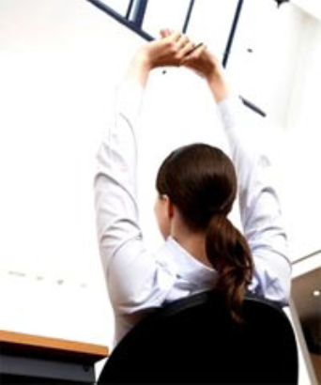
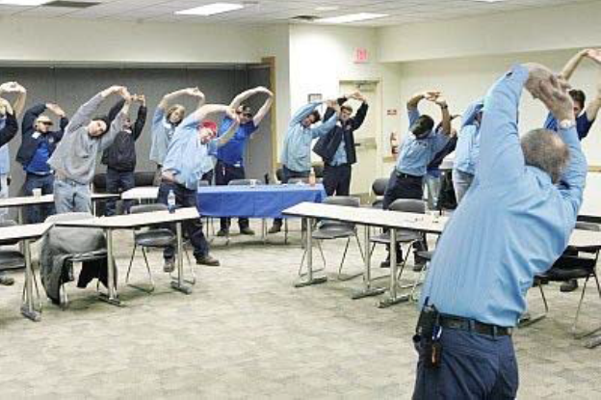
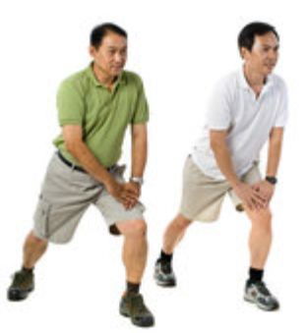
Ideas for reducing overexertion
Just like sports, some pre-stretching before work can really help!
Notes:
When you know that you are going to be doing a lot of lifting, spend 10 mins and do some stretching to prepare your body.

Slide 7
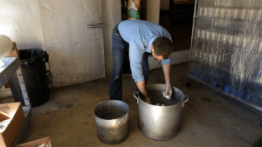
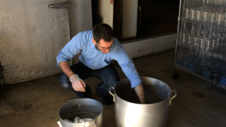
Change the way you work
Instead of this...
Try this...
Notes:
Or raise the work by putting it on the table, allowing you to stand instead.

Slide 8
Here is a quick video
https://www.youtube.com/watch?v=fw5qlfWEaeM
Notes:
RS SafetyTV video - https://www.youtube.com/watch?v=fw5qlfWEaeM

Slide 9
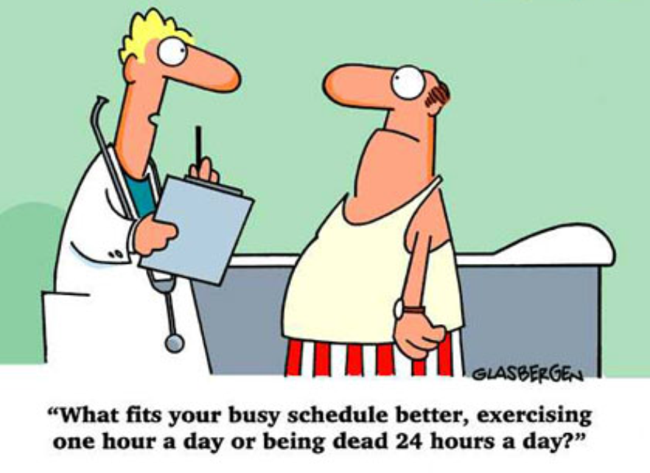
Other helpful tips…
Slow down
Sleep on a firm mattress
Get in shape
Notes:
Slow Down – We find that rushing causes us to not follow the proper steps which can lead to accidents.
Mattress - A firmer mattress gives you better support and hopefully better rest.
Get in shape - We can all do a better job in this area.

Slide 10

Questions

Slide 11
Thank you for your time and if you have additional questions please contact
Safety at Retail Association Services;
360.943.9198
Or
safety@waretailservices.com
Notes:
Any questions? Thank you for coming today!
Additional information:
http://www.distraction.gov/content/about-us/index.html
http://www.textinganddrivingsafety.com/texting-and-driving-stats/
http://www.nsc.org/safety_road/Distracted_Driving/Pages/DistractedDrivingResearchandStatistics.aspx
http://www.cdc.gov/Motorvehiclesafety/Distracted_Driving/
http://www.amazinginfographics.com/statistics-and-facts-about-the-dangers-of-distracted-driving/
http://www.ghsa.org/html/publications/survey/distraction2013.html

Slide 12

Question 1
Overexertion is caused by:
Reaching too far
Lifting improperly
Lifting too much
All of the above
All of the above reasons can result in overexertion injuries.

Slide 13

Question 2
Awkward or bulky loads require:
Extra time.
More tools.
Additional help.
Bigger hand truck.
Extra help will make it easier to carry and reduce the chance of an injury.

Slide 14

Question 3
You can reduce strains and sprains by:
Letting someone else do it.
Always wearing a back brace.
Evaluating your work and changing the task, tools, and equipment.
Carrying more that you can handle.
There is usually equipment to assist you with the task. Always use proper lifting techniques.

Slide 15
Question 4
Overexertion is typically a strain or sprain in the back or shoulder area:
True
False
This is often caused by not working within the body’s normal range.

