Slide 1
How to Have Great Safety Meetings

Slide 2
Why have safety meetings?
They get employees involved in the safety process.
Increases the number of eyes and brains engaged in safety.
Employees develop a sense of "ownership" in the safety efforts.

Slide 3
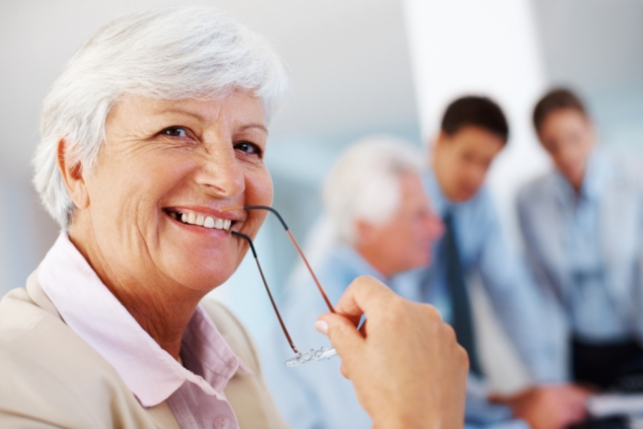
So you are a little uncomfortable?
Well with some preparation you will be a success!
Proper preparation.
Planning will allow for a more relaxed presentation.
Information should travel in both directions.

Slide 4
Ready? Let's plan your meeting like this:

Slide 5
Announce the meeting
Date and time.
Posting it on the break room door, restroom door or other high traffic area.
Don’t get so wrapped up in preparing and forget to let everyone know when and where it will be.

Slide 6
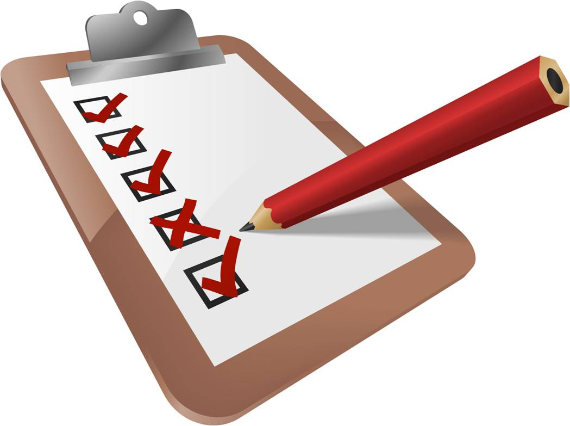
Prepare the agenda.
Pick out the topic ahead of time and collect the safety data you want to present.
Put it all together and decide how it will be presented.
If possible, publish the agenda ahead of time so the attendees will know what to expect and will be prepared.

Slide 7
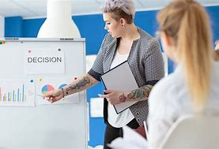
Start the meeting on time
Start the meeting precisely on time, that way the attendees will take your presentation seriously.
Get someone to help with handouts.

Slide 8
Briefly introduce each point of the agenda
An audience that knows what to expect as the meeting progresses will be more attentive.

Slide 9
Inform about safety reports and incidents
Give as much detail as you can without identifying any individuals.
Let them know what happened and what is being done with respect to those issues and any other safety issues that were resolved since the last meeting.
This will help people stay focused on the issue.

Slide 10
Go to the main topic
Take ten minutes and discuss the use of proper use of a tool, or a proper way to use a ladder, or any piece of equipment that your operation uses.
Talk about preventative measures and proper preparation.
Allow free discussion, but make sure the discussion stays on topic.
Encourage participation and you may even want to get someone in the organization to present this portion.
Watch the time because running long is worse than starting late.

Slide 11
End the meeting
With some kind of positive recognition or
Acknowledge someone who identified a key safety issue, someone who performed an outstanding safety act or the unit with the best safety record.
Ask for suggestions as to what to discuss at the next meeting.
End the meeting with positive reinforcement that everyone can see.

Slide 12
Sample Safety Agenda

Slide 13
Safety Meeting Purpose
Meetings raise the employee’s conscious level about the work they are performing.
Safe shop is a more productive shop!
Making it fun and interactive, will make it memorable.

Slide 14
This was created by Retail Association Services, Inc.
With excerpts from:
Washington State Labor and Industries
‘Safety Meeting Topics’ by Peter L. Mitchell
‘How to Conduct a Safety Meeting’ by meetingtomorrow.com
Thanks for coming and work safe!

